Slide 1
Enagás and REN
Coordinated implementation of the Network Code on Capacity Allocation Mechanisms
15 November 2013
20th SG meeting

Slide 2
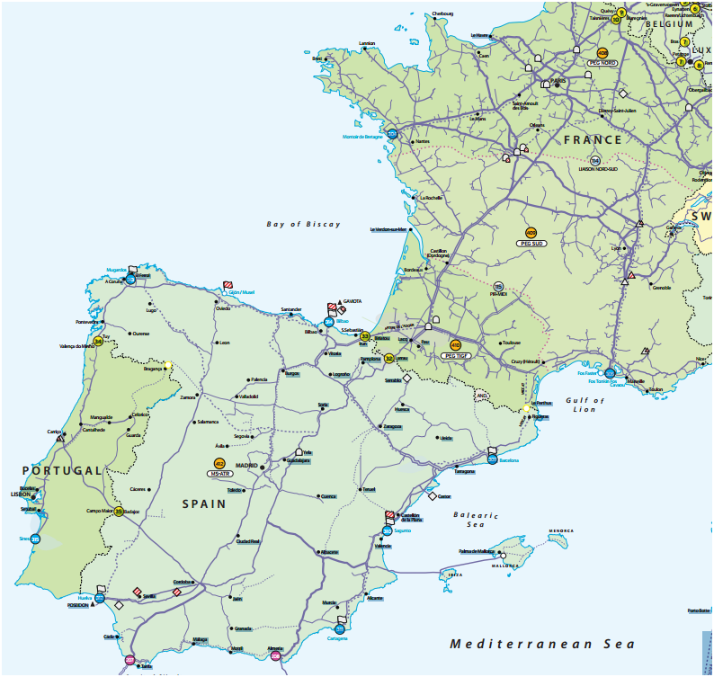
1. VIP
Available capacity at the two existing physical IPs between Spain and Portugal, Badajoz-Campo Maior and Tuy-Valença do Minho, will be offered at a single VIP.
From 1 October 2014 all existing contracts at the physical interconnection points, Badajoz-Campo Maior and Tuy-Valença do Minho, will be transferred into the VIP between Portugal and Spain.
VIP

Slide 3
2. Bundled capacity
Enagás and REN will jointly offer the maximum possible amount of bundled capacity between Spain and Portugal in both flow directions.
According to the CAM NC bundled capacity means a standard capacity product offered on a firm basis, which consists of corresponding entry and exit capacity at both sides of every interconnection point. This implies that:
Each standard product offered includes the same amount of capacity on both sides.
Capacities will be booked through a single allocation procedure.
Capacities will be allocated to the same Shipper at both sides of the IP.
Transactions held on the secondary market must not result in unbundling capacities that were previously offered and allocated as bundled capacities.
This does not imply that a single contract will be put in place. Shippers will have to sign a contract with the respective TSO in order to be allowed to participate in the auctions.

Slide 4
3. Firm and interruptible capacity
All products will be firm unless otherwise stated.
Once the auction for the corresponding firm product has finished, each TSO will decide whether to offer the corresponding interruptible product in a second slot.
Interruptible products will only be offered if 100% of the corresponding firm product has previously been allocated in the related auctions.

Slide 5
4. Standard products
The standard capacity products offered by Enagás and REN will be those included in Article 9 of the CAM NC.
The following standard capacity products will be offered from November 2015:
Yearly standard capacity products
Quarterly standard capacity products
Monthly standard capacity products
Daily standard capacity products
Within-day standard capacity products
During the gas year 2014, Enagás and REN will offer all standard capacity products except within-day standard capacity products, which will be available from November 2015.

Slide 6
5. Auctions
2014 auctions
Until the binding application of the CAM NC as from November 2015 the following auctions will be held for bundled and unbundled products:
Annual yearly capacity auctions
Annual quarterly capacity auctions
Rolling monthly capacity auctions
Daily products will be allocated through FCFS until November 2015, except for current daily unbundled products available on the Portuguese side, which will be allocated through auctions
2015 auctions and onwards
As from November 2015, Enagás and REN will implement all the auctions included in the CAM NC. Thus, no capacity will be allocated on FCFS basis.

Slide 7
6. Auction algorithms
Ascending clock auction algorithm
For annual yearly, annual quarterly and rolling monthly capacity auctions, an ascending clock algorithm with multiple bidding rounds shall be applied.
The ascending clock auction algorithm to be applied is described in Article 17 of the CAM NC.
Uniform-Price auction algorithm
For rolling day-ahead and within-day capacity auctions a uniform-price auction algorithm with a single bidding round shall be applied.
The uniform-price auction algorithm to be applied is described in Article 18 of the CAM NC.

Slide 8
7. Booking platform
All bundled capacity auctions will be carried out via PRISMA booking platform:
https://primary.prisma-capacity.eu/
Shippers may register at PRISMA platform as from January 2014. There will be a 8 week period available for Shipper’s registration before the first auction, March 2014.
In order to present to Shippers the new booking platform, Enagás and REN shall perform 2 training workshops with the participation of PRISMA experts. These will take place in January 2014 and will give the opportunity to Shippers to get acquainted with the platform.

Slide 9
8. Requirements to participate
In order to participate in an auction, Shippers and eligible customers licensed in Portugal and Spain (“Shippers”) shall be registered at PRISMA booking platform.
The requirements for registration are established in the PRISMA General Terms and Conditions (currently under revision, so new version of GTCs is expected as from 1st January 2014).
EIC
The first requirement for registration is to have a valid Energy Identification Code (EIC).
The EIC consists of 16 characters given to a market party to be identified in the Energy Internal European Market in a harmonized way.
Since 1 March 2013, ENTSOG is acting as Local Issuing Office for the EIC. The code shall be globally unique: only one code is allocated per organization (business group); the same Shipper on both sides of the border will have the same EIC code.
1
http://www.entsog.eu/eic-codes/eic-party-codes-x-request

Slide 10
8. Requirements to participate
2
Registration to use PRISMA
According to PRISMA GTCs, the registration process of the Shipper and its first user requires the following information to be provided to PRISMA:
Energy Identification Code of the Shipper (EIC).
Company name and address of the Shipper.
User information: title, last name, first name, telephone number, e-mail address.
Other Shipper information: billing address, IBAN, BIC, legal representatives and VAT number.
Additional identification code if requested by TSO.
Registration to conclude bookings and to participate in auctions
Adjacent TSOs on both sides of a border must approve users’ registration request. At this stage, TSOs must confirm that the Shipper is allowed to operate in their country, according to the national regulatory framework (if the Shipper has trading license where required, etc...).
3

Slide 11
8. Requirements to participate
Shipper registration process is detailed in the figure below, further information will be provided by PRISMA and TSOs.

Slide 12
8. Requirements on the Spanish side
In order to be able to participate in auctions Shippers must be registered as licensed Shippers in the Spanish system. The requirements and procedure to get the license are detailed by the MINETUR at the following link:
http://www.minetur.gob.es/energia/gas/Requisitos/Paginas/comercializador.aspx
Then, Shippers will have to sign the Standard Contract with Enagás in advance in order to participate in the auctions.
The Standard Contract will only be signed once during the registration process to conclude bookings and to participate in auctions with Enagás at PRISMA booking platform.
Capacity allocated to a Shipper at PRISMA booking platform will be automatically introduced at the SL-ATR, thus this allocation will be binding for Shippers and it will not be necessary to sign any additional document.
Once the Shipper has been informed of the allocation of capacities, it will be informed of the financial guarantees associated to the contracted capacity he has to put in place in favor of Enagás. These financial guarantees are detailed in Royal Decree 949/2001.
No financial guarantees to participate in the auctions will be required.

Slide 13
8. Requirements on the Portuguese side
In order to be able to participate in auctions Shippers must have concluded their registration process at DGEG (Direção Geral de Energia e Geologia), the Portuguese governmental entity responsible for the registration process, in respect to the Decree-Law 231/2012, of 26 of October. More information available in:
http://www.dgeg.pt/
Before participating in the first auction, Shippers will have to sign the Standard Contract with REN and present financial guaranties in favor of REN-Gasodutos, S.A., that are meant to cover their participation in each auction process.
As capacity is being allocated after each auction, it will be joined to the contract via an annex for each contracted product.
As current Shippers shall already have presented financial guaranties to REN in relation to the Network Utilization Contract before, these shall be taken into account when calculating the new guaranties.

Slide 14
9. 2014 Calendar

Slide 15
Thank you for your attention
15 November 2013
20th SG meeting

